Slide 1

Python Programming

Slide 2
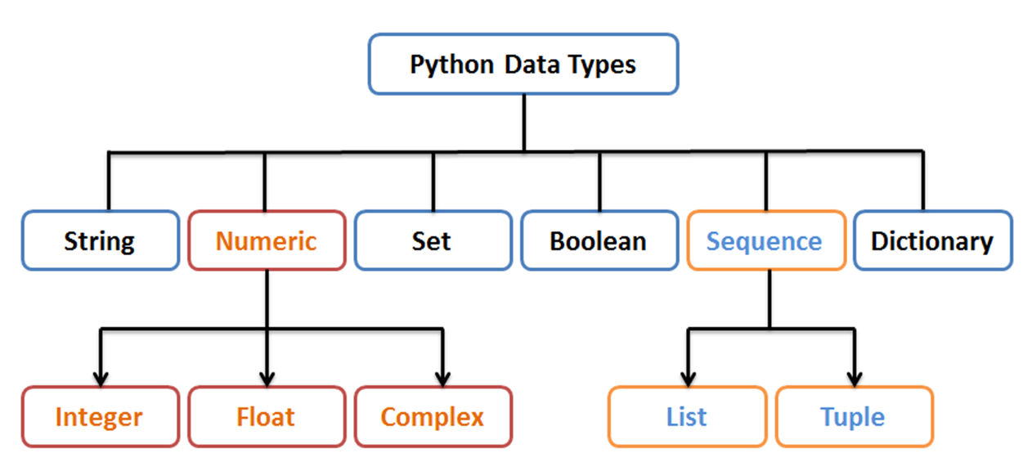
Dictionary
Mirror image

Slide 3
Creating empty Dictionary
Using curly braces {}
>>> myDict = {}
>>> type(myDict)
<class 'dict'>
Using keyword dict()
>>> myDict = dict()
>>> myDict
{}

Slide 4
Dictionary
Unordered
Each item is a Key-Value pair
Keys are unique
Keys are immutable.
  Strings, numbers or tuples allowed. No list.

Slide 5
Creating dictionary with elements
>>> myDict = {"Program":"MCA", "Course":"Python", "Semester":1}
>>> print(myDict)
{'Program': 'MCA', 'Course': 'Python', 'Semester': 1}
# integers as keys
>>> courses = {1:"Python", 2:"Java", 3:"OS"}
>>> print(courses)
{1: 'Python', 2: 'Java', 3: 'OS'}

Slide 6
Dictionary comprehension
Can create using dictionary comprehension
>>> squares = {x:x**2 for x in range(1,6)}
>>> print(squares)
{1: 1, 2: 4, 3: 9, 4: 16, 5: 25}

Slide 7
Unique keys
>>> courses = {1:"Python", 2:"Java", 3:"OS", 2:'DBMS'}
>>> print(courses)
{1: 'Python', 2: 'DBMS', 3: 'OS’}
No duplicate key is allowed. If any, last value is assigned

Slide 8
Accessing values
Using keys as indices
>>> myDict = {"Program":"MCA", "Course":"Python", "Semester":1}
>>> print(myDict["Course"])
Python
Using get() method
>>> print(myDict.get("Program"))
MCA

Slide 9
Changing values
Use keys as indices
>>> courses = {1:"Python", 2:"Java", 3:"OS"}
>>> courses[3] = "DBMS"
>>> print(courses)
{1: 'Python', 2: 'Java', 3: 'DBMS'}

Slide 10
Traversing a dictionary - 1
Using items() method
Syntax: for key, val in dict.items():
print(key, ":", val)
>>> courses = {1:"Python", 2:"Java", 3:"OS"}
>>> for key,value in courses.items():
print("{}:{}".format(key,value))
1:Python
2:Java
3:OS

Slide 11
Traversing a dictionary - 2
Using keys() method
Syntax: for key in dict.keys():
print(dict[key])
>>> courses = {1:"Python", 2:"Java", 3:"OS"}
>>> for key in courses.keys():
print(courses[key])
Python
Java
OS

Slide 12
Traversing a dictionary - 3
Using values() method
Syntax: for val in dict.values():
print(val)
>>> courses = {1:"Python", 2:"Java", 3:"OS"}
>>> for value in courses.values():
print(value)
Python
Java
OS

